Slide 1

Slide 1
AMAZON SALES DATA ANALYSIS
REPORT
ISHAN CHAURASIA

Slide 2

Slide 2
OBJECTIVE
Sales management has gained importance to meet increasing competition and the need for improved methods of distribution to reduce cost and to increase profits. Find sales and profit trends month-wise, quarter-wise and year-wise.
BENEFITS
Help out to make better business decisions.
Help analyse customer trends satisfaction, which can lead to new and better products and services.
Gives better insight of customer base.
PROBLEM STATEMENT
Develop a report by Extracting-Transforming-Loading of data which contains Sales trend by Year, Quarter, Month and find relationship through data to understand and analyse the facts.
1

Slide 3
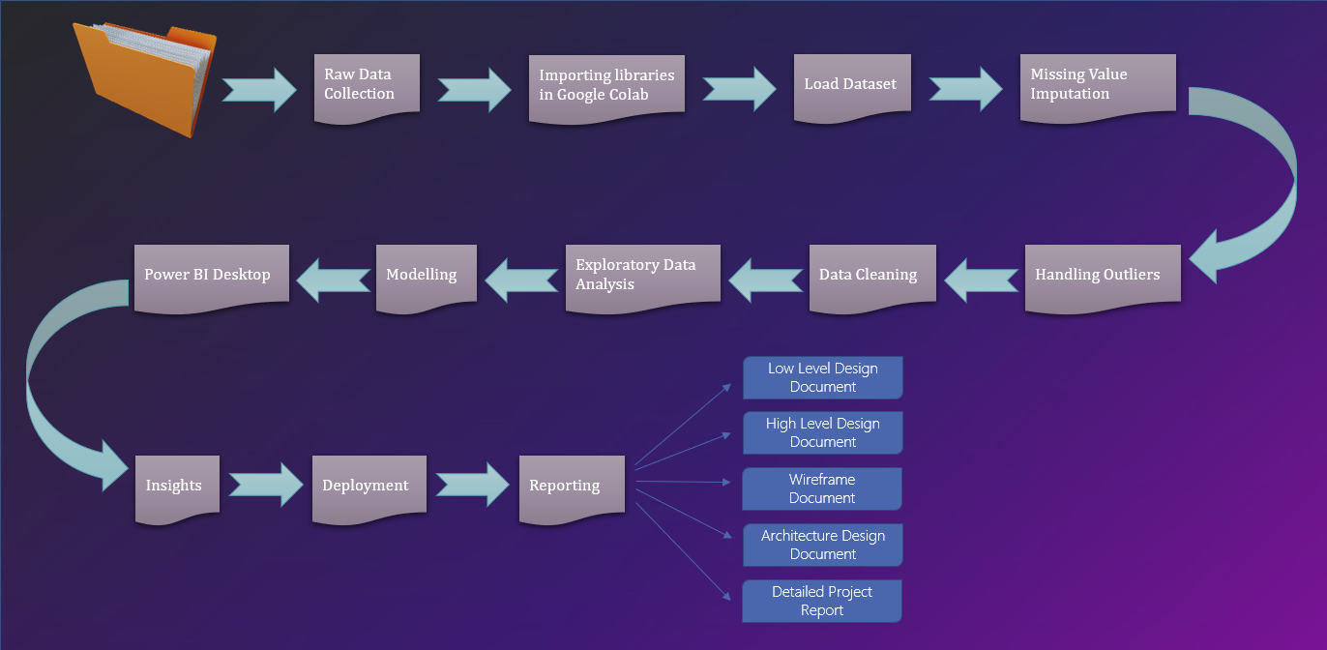
ARCHITECTURE
2

Slide 4
Quick Insight
Yearly analysis of customers, total items sold, total sales and total profit over the years.
3

Slide 5


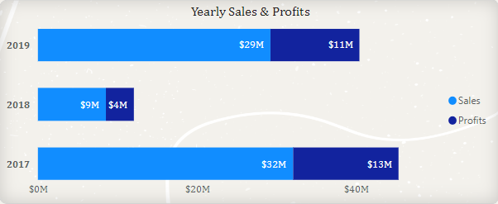
Slide 7
2019
2018
The profit in 2017 was $13M USD, which dropped sharply to $4M USD in 2018, representing only 30% of the previous year’s profit. However, in 2019, the profit rebounded to $11M USD, which was 275% higher than the 2018 figure and 84% of the 2017 level.
2017

Slide 6

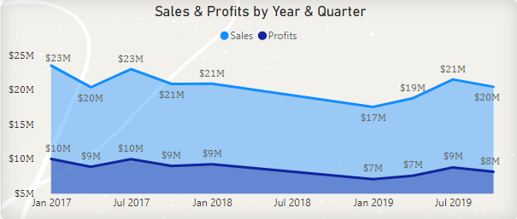
Slide 10
Sales & Profits by Year-Quarter
The profit in 2017 fluctuated across the four quarters, starting with $10M in Q1, dropping to $9M in Q2, rising to $10M in Q3, and falling to $9M in Q4. The profit in 2018 showed a slight increase in Q1 to $9M, but then declined sharply by 22.38% to $6.92M in Q2. The profit in 2019 recovered gradually from Q2 onwards, reaching $9M in Q3, which was 24.35% higher than the same quarter in 2018.
5

Slide 7
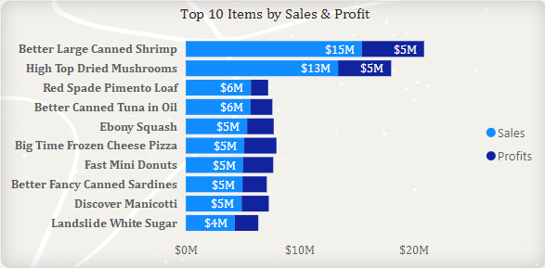
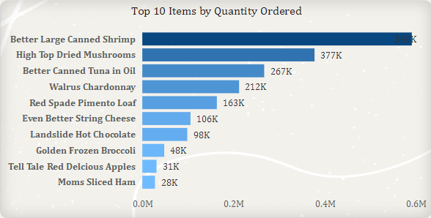
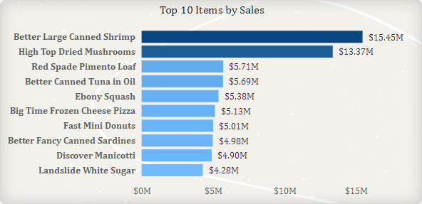
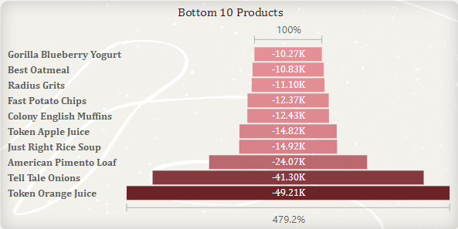
Slide 6
SALES INSIGHTS
6

Slide 8
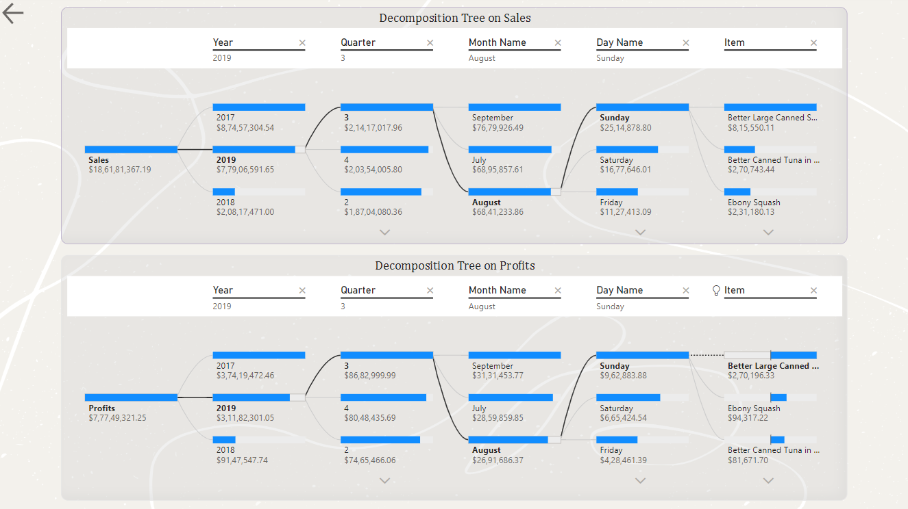
Slide 3
DETAILED ANALYSIS
7
7

Slide 9
CONSLUSION
2017 had the highest revenue 87M USD , followed by 2019 28M USD and 2018 at 21M USD.
If we closely observe, most sales happened in the month of March, followed by June and September over the years.
Sales took a dip in the following months May, July, October. Amazon should probably come up with some discounts and gift card initiatives to boost up the sales.
Products ‘Better Large Canned Shrimp’, ‘High Dried Mushrooms’ and ‘Red Spade Pimento Loaf’ were the most profitable items in the entire store.
‘Token Orange Juice’, ‘Tell Tale Onions’ and ‘American Pimento Loaf’ were the highest loss making products.
8

Slide 10

Slide 11
THANK YOU

